Slide 1
Chapter 8 Random-Variate Generation
Banks, Carson, Nelson & Nicol
Discrete-Event System Simulation

Slide 2
Contents
Inverse-transform Technique
Acceptance-Rejection Technique
Special Properties

Slide 3
Purpose & Overview
Develop understanding of generating samples from a specified distribution as input to a simulation model.
Illustrate some widely-used techniques for generating random variates:
Inverse-transform technique
Acceptance-rejection technique
Special properties

Slide 4
Preparation
It is assumed that a source of uniform [0,1] random numbers exists.
Linear Congruential Method (LCM)
Random numbers R, R , R , … with
f(x)
1 2
PDF
0 ≤ x ≤ 1 otherwise
f (x) = ^{⎧1}
R
⎨₀
⎩
0
F(x)
x
1
CDF
⎧0 x < 0
0 ≤ x ≤ 1
x > 1
F (x) = ⎮x
R
⎨
⎮₁
⎩
x
0
1

Slide 5
Inverse-transform Technique

Slide 6
Inverse-transform Technique
The concept:
For CDF function: r = F(x)
Generate r from uniform (0,1), a.k.a U(0,1)
Find x, x = F⁻¹(r)
F(x)
F(x)
1
1
r = F(x)
r = F(x)
r₁
r₁
r₂
x
x
x₁
x₂ x₁

Slide 7
Inverse-transform Technique
The inverse-transform technique can be used in principle for any distribution.
Most useful when the CDF F(x) has an inverse F ⁻¹(x)
which is easy to compute.
Required steps
Compute the CDF of the desired random variable X
Set F(X) = R on the range of X
Solve the equation F(X) = R for X in terms of R
Generate uniform random numbers R₁, R₂, R₃, ... and compute the desired random variate by X_{i} = F⁻¹(R_{i})

Slide 8
Inverse-transform Technique: Example
Exponential Distribution
PDF
f (x) = λe^{−λx}
CDF
F (x) = 1− e^{−λx}
To generate X₁, X₂, X₃
1− e^{−λx}=R
_{e}−λX
= 1− R
− λX = ln(1− R)
_{X =} ln(1− R)
− λ
_{X = −} ln(1− R)
λ
Simplification
X = −
ln(R)
λ
X = F ⁻¹ (R)
Since R and (1-R) are uniformly distributed on [0,1]

Slide 9
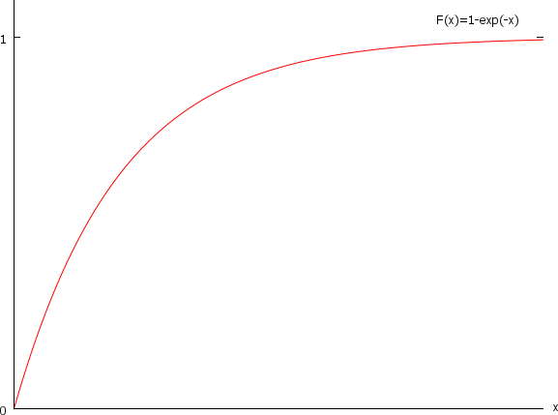
Inverse-transform Technique: Example

Slide 10
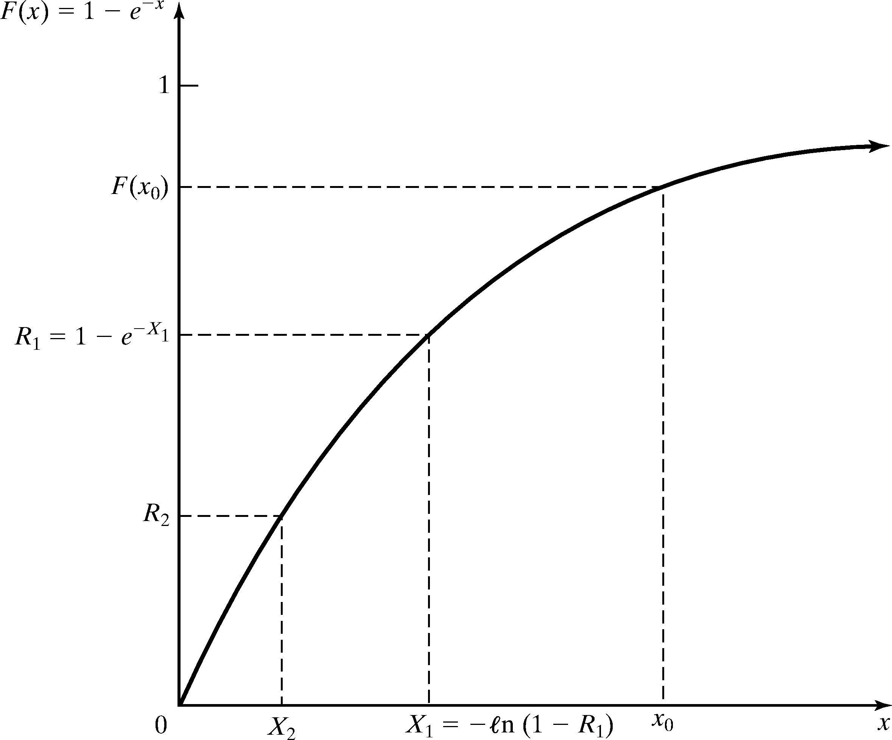
Inverse-transform Technique: Example
Inverse-transform technique for exp(λ = 1)

Slide 11




















Inverse-transform Technique: Example
Example:
Generate 200 or 500 variates X_{i} with distribution exp(λ= 1)
Generate 200 or 500 R_{s} with U(0,1), the histogram of X_{s} becomes:
0,7
0,6
0,6
0,5
0,5
0,4
0,4
0,3
0,3
0,2
0,2
0,1
0,1
0
0
0,5 1 1,5 2 2,5 3 3,5 4 4,5 5 5,5 6 6,5 7
Empirical Histogram
0,57
1,15
1,72
2,30 2,87 3,45 4,02 4,60 5,17 5,75
Rel Prob. Theor. PDF

Slide 12
Inverse-transform Technique
Check: Does the random variable X₁ have the desired distribution?
P( X₁ ≤ x₀ ) = P(R₁ ≤ F(x₀ )) = F(x₀ )

Slide 13
Inverse-transform Technique: Other Distributions
Examples of other distributions for which inverse CDF works are:
Uniform distribution
Weibull distribution
Triangular distribution

Slide 14
Other Distributions [Inverse-transform]
Examples of other distributions for which inverse cdf works are:
Uniform distribution
X = a + (b – a)R
Weibull distribution – time to failure –
X = α[- ln(1 - R)]^{1/β}
Triangular distribution
Notes:
where r is a variate generated from Uniform (0,1)
and F-1(r) is the solution to the equation r = F(X)

Slide 15
Inverse-transform Technique: Uniform Distribution
Random variable X uniformly distributed over [a, b]
F ( X ) = R
X − a
b − a ^{= R}
X − a = R(b − a)
X = a + R(b − a)

Slide 16
Inverse-transform Technique: Weibull Distribution
The Weibull Distribution is • The variate is described by
F ( X ) = R
−( )
β
X
α
PDF
1− e = R
β
_{α} β
−( )
β
−(
)
f (x) =
β −1
x
β
x e
α
X
α
e = 1− R
− ( ) = ln(1− R)
X
α
β
CDF
_{X} β
_{α β} = −ln(1− R)
−( )
β
F(X ) = 1− e
x
α
_{X} β
= −α ^{β} ⋅ln(1− R)
X^{β .1/β} = −α ^{β 1/β}⋅ln(1− R) ^{β}
X ¹ = α ¹ (− ln(1− R)) ^{β}
X = α [− ln(1− R)] ^{β}

Slide 17
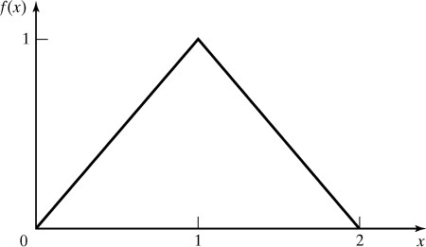
Inverse-transform Technique: Triangular Distribution
The CDF of a Triangular Distribution with endpoints (0, 2) is given by
⎧0
⎮ x²
x ≤ 0
0 < x ≤ 1
⎧
⎮
_{X} 2
⎮ ₂
0 ≤ X ≤ 1
F (x) = ⎨
R( X ) = ⎨
2
(2 − X )²
(2 − x)²
1 < x ≤ 2
x > 2
⎮1−
⎮
⎮1−
1 ≤ X ≤ 2
2
⎮⎩
2
⎮⎩1
X is generated by
⎧
2R
0 ≤ R ≤ ¹
X = ⎨
2
2 −
2(1− R)
¹ < R ≤ 1
⎩
2

Slide 18
Inverse-transform Technique: Empirical Continuous Distributions
When theoretical distributions are not applicable
To collect empirical data:
Resample the observed data
Interpolate between observed data points to fill in the gaps

Slide 19
Empirical Continuous Dist’n [Inverse-transform]
When theoretical distribution is not applicable
To collect empirical data:
Resample the observed data (i.e. use the data for the distribution)
Interpolate between observed data points to fill in the gaps
For a small sample set (size n):
Arrange the data from smallest to largest
Assign the probability 1/n to each interval
where
Notes:
where r is a variate generated from Uniform (0,1)
and F-1(r) is the solution to the equation r = F(X)

Slide 20
Inverse-transform Technique: Empirical Continuous Distributions
For a small sample set (size n):
Arrange the data from smallest to largest
^{x}(1) ^{≤ x} (2) ^{≤…≤ x} (n)
Set x₍₀₎=0
Assign the probability 1/n to each interval
^{x}(i-1) ^{≤ x ≤ x} (i)
i = 1,2,…, n
The slope of each line segment is defined as
x
(i) ^{− x}(i−1) ^{x}(i)
=
^{− x}(i−1)
1
a =
i
i (i −1)
_{n} −
n
n
The inverse CDF is given by
_{+ a} ⎛⎛ _{R −} (i −1) ⎞
(i −1) i
_{n} < R ≤ _{n}
X = F^{ˆ −1} (R) = x
_{i} ⎮ ⎮
when
(i−1)
⎛
n
⎠

Slide 21
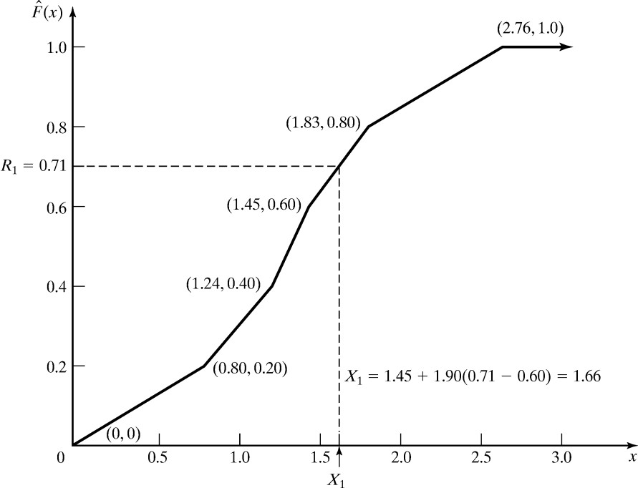
Inverse-transform Technique: Empirical Continuous Distributions
i | Interval | PDF | CDF | Slope a_{i}
1 | 0.0 < x ≤ 0.8 | 0.2 | 0.2 | 4.00
2 | 0.8 < x ≤ 1.24 | 0.2 | 0.4 | 2.20
3 | 1.24 < x ≤ 1.45 | 0.2 | 0.6 | 1.05
4 | 1.45 < x ≤ 1.83 | 0.2 | 0.8 | 1.90
5 | 1.83 < x ≤2.76 | 0.2 | 1.0 | 4.65
R₁ = 0.71
^{X}1 ^{= x}(4−1)
+ a₄ (R₁ − (4 −1) / n)
= 1.45 +1.90(0.71 − 0.6)
= 1.66

Slide 22
Inverse-transform Technique: Empirical Continuous Distributions
What happens for large samples of data
Several hundreds or tens of thousand
First summarize the data into a frequency distribution with smaller number of intervals
Afterwards, fit continuous empirical CDF to the frequency distribution
Slight modifications
Slope
c_{i} cumulative probability of the first i intervals
a =
^{x}(i ) ^{− x}(i−1)
i
^{c}i ^{− c}i−1
The inverse CDF is given by
X = F^{ˆ −1} (R) = x
a (R − c
) when
c_{i−1} < R ≤ c_{i}
(i−1)
i
i−1

Slide 23
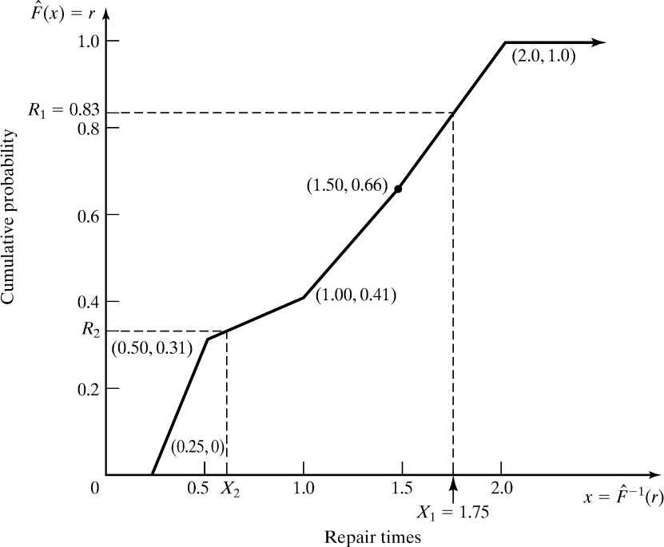
Inverse-transform Technique: Empirical Continuous Distributions
Example: Suppose the data collected for 100 broken-widget repair times are:
Interval (Hours) |  | Frequency | Relative Frequency | Cumulative Frequency, c _{i} | Slope, a _{i}
0.25 ≤ x | ≤ 0.5 | 31 | 0.31 | 0.31 | 0.81
0.5 ≤ x | ≤ 1.0 | 10 | 0.10 | 0.41 | 5.00
1.0 ≤ x | ≤ 1.5 | 25 | 0.25 | 0.66 | 2.00
1.5 ≤ x | ≤ 2.0 | 34 | 0.34 | 1.00 | 1.47
Consider R₁ = 0.83:
c₃ = 0.66 < R₁ < c₄ = 1.00
^{X}1 ^{= x}(4-1) ^{+ a}4^{(R}1 ^{– c}(4-1)⁾
= 1.5 + 1.47(0.83-0.66)
= 1.75

Slide 24
Consider R₁ = 0.83:
c₃ = 0.66 < R₁ < c₄ = 1.00
^{X}1 ^{= x}(4-1) ^{+ a}4^{(R}1 ^{– c}(4-1)⁾
= 1.5 + 1.47(0.83-0.66)
= 1.75

Slide 25
Inverse-transform Technique: Empirical Continuous Distributions
Problems with empirical distributions
The data in the previous example is restricted in the range
0.25 ≤ X ≤ 2.0
The underlying distribution might have a wider range
Thus, try to find a theoretical distribution
Hints for building empirical distributions based on frequency tables
It is recommended to use relatively short intervals
Number of bins increase
This will result in a more accurate estimate

Slide 26
Inverse-transform Technique: Continuous Distributions
A number of continuous distributions do not have a closed form expression for their CDF, e.g.
Normal
Gamma
Beta
The presented method does not work for these distributions
Solution
Approximate the CDF or numerically integrate the CDF
Problem
Computationally slow

Slide 27
Inverse-transform Technique: Discrete Distribution
All discrete distributions can be generated via inverse- transform technique
Method: numerically, table-lookup procedure, algebraically, or a formula
Examples of application:
Empirical
Discrete uniform
Geometric

Slide 28
Inverse-transform Technique: Discrete Distribution
Example: Suppose the number of shipments, x, on the loading dock of a company is either 0, 1, or 2
Data - Probability distribution:
x | P(x) | F(x)
0 | 0.50 | 0.50
1 | 0.30 | 0.80
2 | 0.20 | 1.00
The inverse-transform technique as table-lookup procedure
F(x_{i−1} ) = r_{i−1} < R ≤ r_{i} = F(x_{i} )
Set X = x_{i}

Slide 29
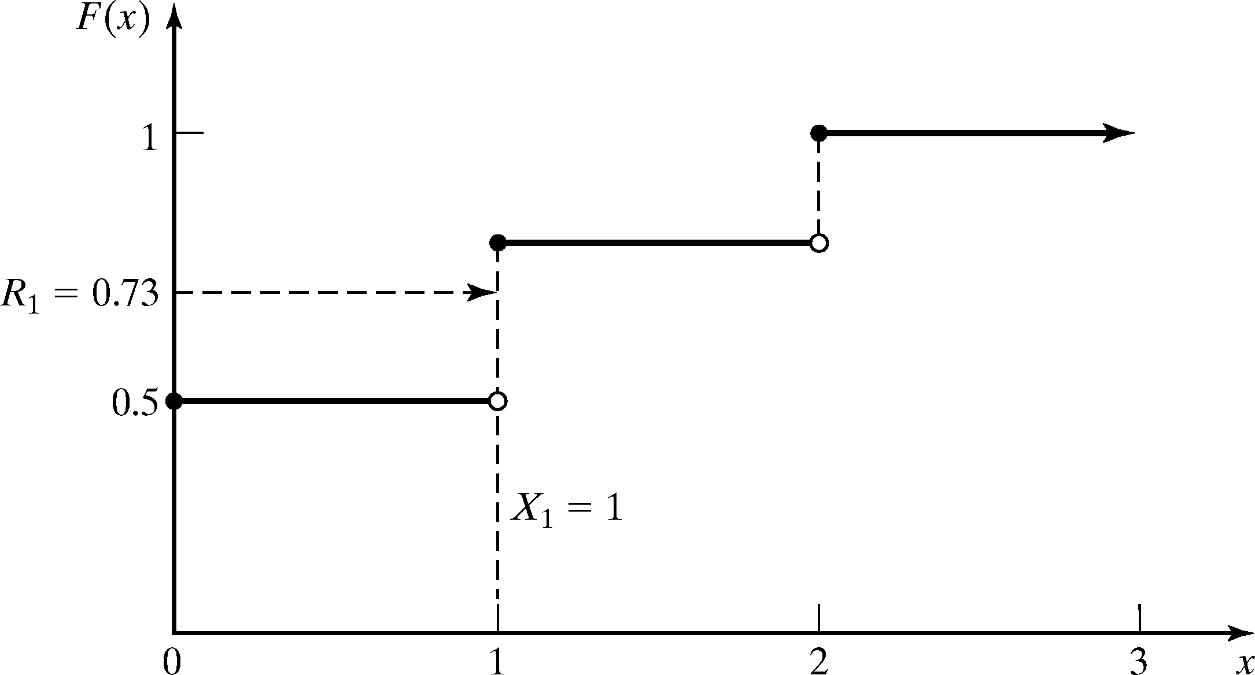
Inverse-transform Technique: Discrete Distribution
Method - Given R, the generation scheme becomes:
0.8
0, R ≤ 0.5
0.5 < R ≤ 0.8
2, 0.8 < R ≤ 1.0
x = 1,
⎨
Table for generating the discrete variate X
Consider R₁ = 0.73:
F(x_{i-1}) < R ≤ F(x_{i})
F(x₀) < 0.73 ≤ F(x₁)
Hence, X₁ = 1
i | Input r_{i} | Output x_{i}
1 | 0.5 | 0
2 | 0.8 | 1
3 | 1.0 | 2

Slide 30
Acceptance-Rejection Technique

Slide 31













Acceptance-Rejection Technique
Useful particularly when inverse CDF does not exist in closed form
Thinning
Illustration: To generate random variates, X ~ U(1/4,1)
Generate R
Procedure:
Step 1. Generate R ~ U(0,1)
Step 2. If R ≥ ¼, accept X=R.
Step 3. If R < ¼, reject R, return to Step 1
no
Condition
yes
Output R’
R does not have the desired distribution, but R conditioned (R’) on the event {R ≥ ¼} does.
Efficiency: Depends heavily on the ability to minimize the number of rejections.

Slide 32
Acceptance-Rejection Technique: Poisson Distribution
Probability mass function of a Poisson Distribution
_{α}n
P(N = n) =
_{e}−α
n!
Exactly n arrivals during one time unit
A₁ + A₂ +☹+ A_{n} ≤ 1 < A₁ + A₂ +☹+ A_{n} + A_{n+1}
Since interarrival times are exponentially distributed we can set
ln(R )
A =
i
i
α
Well known, we derived this generator in the beginning of the class

Slide 33
Acceptance-Rejection Technique: Poisson Distribution
Substitute the sum by
n
ln(R_{i} ) − ln(R_{i} )
n+1
∑
≤ 1 < ∑
α α
i=1 i=1
Simplify by
multiply by -α, which reverses the inequality sign
sum of logs is the log of a product
n n+1
∑ln(R_{i} ) ≥ −α > ∑ln(R_{i} )
i=1
i=1
n+1
n
ln∏ R_{i} ≥ −α > ln∏ R_{i}
i=1
i=1
Simplify by e^{ln(x)} = x
n
n+1
∏ i
R ≥ e > ∏ R
−α
i
i=1
i=1

Slide 34
Acceptance-Rejection Technique: Poisson Distribution
Procedure of generating a Poisson random variate N is as follows
Set n=0, P=1
Generate a random number R_{n+1}, and replace P by P x R_{n+1}
If P < e^{-α} then accept N=n
Otherwise, reject the current n, increase n by one, and return to step 2.

Slide 35
Acceptance-Rejection Technique: Poisson Distribution
Example: Generate three Poisson variates with mean α=0.2
e^{-α} = e ^{(-0.2)} = 0.8187
Variate 1
Step 1: Set n = 0, P = 1
Step 2: R1 = 0.4357, P = 1 x 0.4357
Step 3: Since P = 0.4357 < e ^{(-0.2)}, accept N = 0
Variate 2
Step 1: Set n = 0, P = 1
Step 2: R1 = 0.4146, P = 1 x 0.4146
Step 3: Since P = 0.4146 < e ^{(-0.2)}, accept N = 0
Variate 3
Step 1: Set n = 0, P = 1
Step 2: R1 = 0.8353, P = 1 x 0.8353
Step 3: Since P = 0.8353 > e ^{(-0.2)} , reject n = 0 and return to Step 2 with n = 1
Step 2: R2 = 0.9952, P = 0.8353 x 0.9952 = 0.8313
Step 3: Since P = 0.8313 > e ^{(-0.2)} , reject n = 1 and return to Step 2 with n = 2
Step 2: R3 = 0.8004, P = 0.8313 x 0.8004 = 0.6654
Step 3: Since P = 0.6654 < e ^{(-0.2)}, accept N = 2

Slide 36
Acceptance-Rejection Technique: Poisson Distribution
It took five random numbers to generate three Poisson variates
In long run, the generation of Poisson variates requires some overhead!
N | ^{R}n+1 | P | Accept/Reject |  | Result
0 | 0.4357 | 0.4357 | P < e^{-α} | Accept | N=0
0 | 0.4146 | 0.4146 | P < e^{-α} | Accept | N=0
0 | 0.8353 | 0.8353 | P ≥ e^{-α} | Reject
1 | 0.9952 | 0.8313 | P ≥ e^{-α} | Reject
2 | 0.8004 | 0.6654 | P < e^{-α} | Accept | N=2

